Slide 1
Rockbuster analysis prepared by: Michael harkness

Slide 2
overview
Rockbuster is a video rental company that previously had stores across the world.
To compete with Netflix and Amazon, Rockbuster is making a move toward streaming services.
This is an overall analysis of the company.

Slide 3
Summary
COMPANY STATISTICS
Total revenue: | $61,312.04
Average revenue per customer: | $102.36
Total number of customers: | 599
Number of countries: | 109
FILM STATISTICS
Average rental rate: | $2.98
Average rental duration: | 5 days
Average film length: | 115 minutes
Most common rating: | PG-13

Slide 4
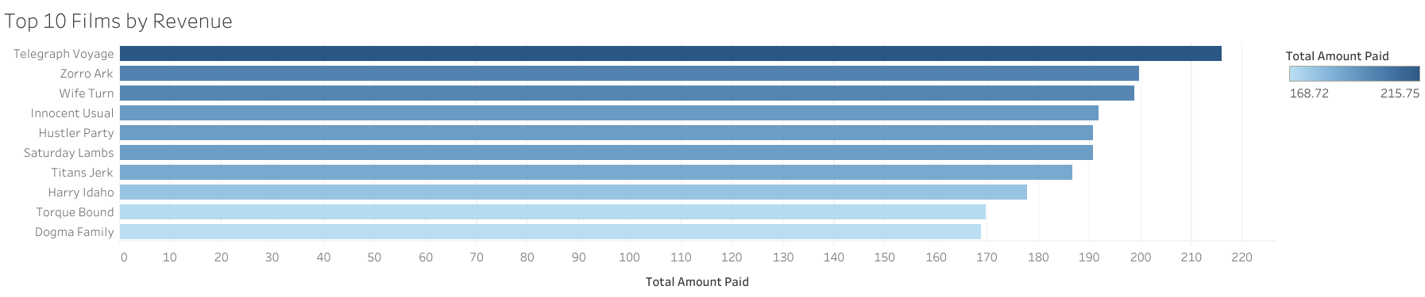
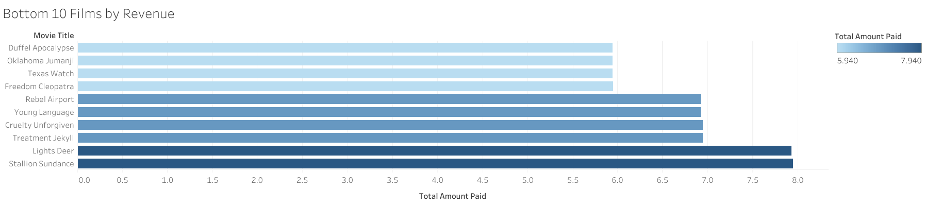
Best and worst performing films

Slide 5
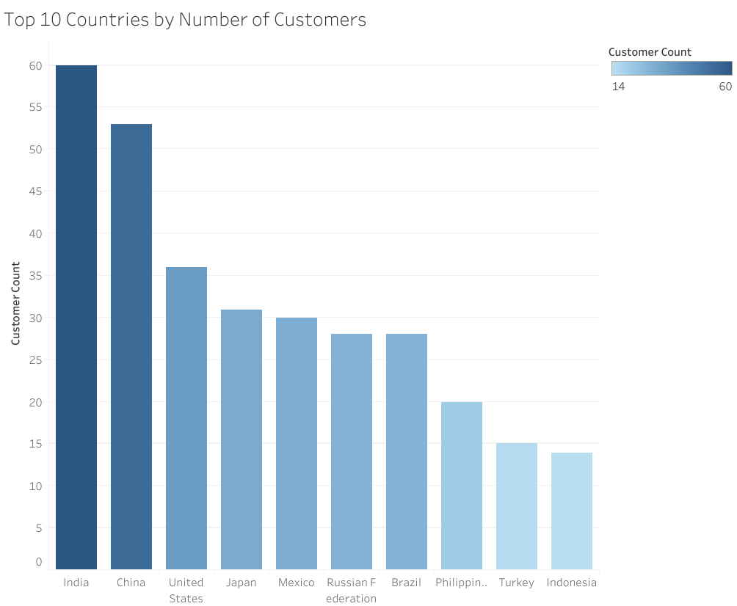
Top 10 countries by number of customers

Slide 6
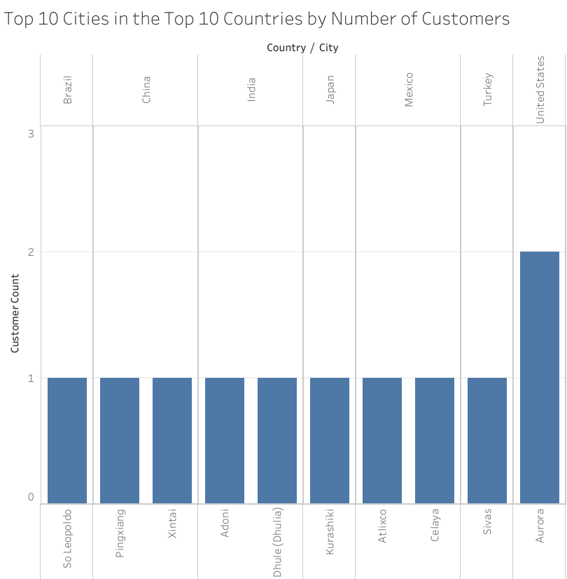
Top 10 cities in the top 10 countries

Slide 7
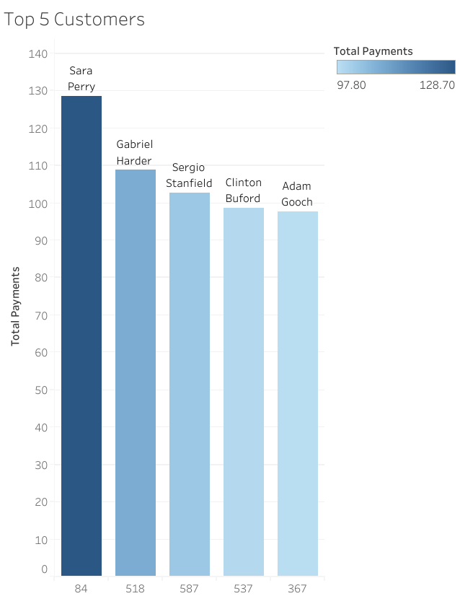
Top 5 customers in the top 10 cities in the top 10 countries
Name | City | Country | Total Amount
Sara Perry | Atlixco | Mexico | 128.7
Gabriel Harder | Sivas | Turkey | 108.75
Sergio Stanfield | Celaya | Mexico | 102.76
Clinton Buford | Aurora | United States | 98.76
Adam Gooch | Adoni | India | 97.8

Slide 8
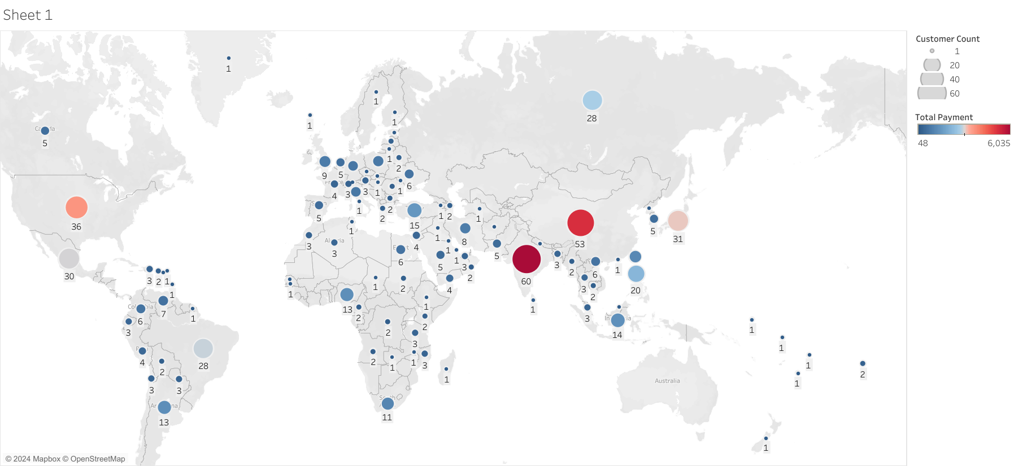
Map Of customer distribution

Slide 9
Conclusion & Recommendations
Focus advertising on countries with highest revenue: India, China, United States
Institute loyalty program for highest revenue customers.
Increase marketing budget for top 10 highest grossing films.

Slide 10
THANK YOU for your time!
MICHAEL HARKNESS
610.457.9675
harkness.michael@gmail.com

